Slide 1
[Name of Presenter]
[Title]
[Name of Division]

Slide 2
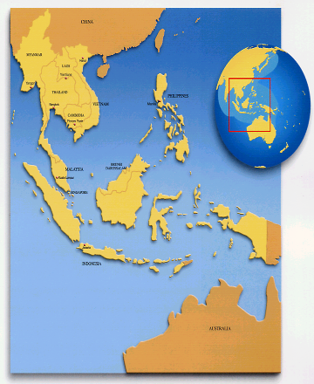
Association of Southeast Asian Nations (ASEAN)
1967
Indonesia
Malaysia
Philippines
Singapore
Thailand
(8 August)
1984
Brunei Darussalam
(7 January)
1995
Viet Nam
(28 July)
1997
Lao PDR
Myanmar
(23 July)
1999
Cambodia
(30 April)

Slide 3
ASEAN Emblem
The ASEAN Emblem represent a stable, peaceful, united, and dynamic ASEAN.
The Colour of The ASEAN Emblem –blue, white, red, and yellow– represent the main colours of the state crests of all the ASEAN Member States.
Blue → Peace and Stability
White → Purity
Red → Brave and Dynamism
Yellow → Prosperity
Notes:
The ASEAN Emblem shall be the official emblem of ASEAN. The ASEAN Emblem is the reserved copyright of ASEAN.
The blue represents peace and stability. Red depicts courage/ brave and dynamism, white shows purity and yellow symbolises prosperity.
The stalks of padi in the centre of the Emblem represent the dream of ASEAN’s Founding Fathers for an ASEAN comprising all the countries in Southeast Asia, bound together in friendship and solidarity.
The circle represents the unity of ASEAN.

Slide 4
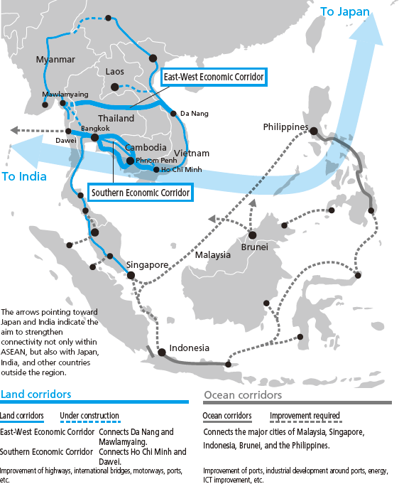
ASEAN – A well-connected region
Free trade agreements with major regional economies
Highly connected physically, institutionally and among the Peoples
Notes:
Highly connected region: Indonesia’s mobile phone penetration: 109%; Bangkok is the Facebook capital of the world; 81% of Vietnamese use social media; Philippines has 30 million Facebook users
Young educated labour force: youth aged 15-29 account for 27% of ASEAN’s population; they are mostly educated and tech savvy
ASEAN signed FTAs with China, Japan, South Korea, India, New Zealand and Australia.

Slide 5
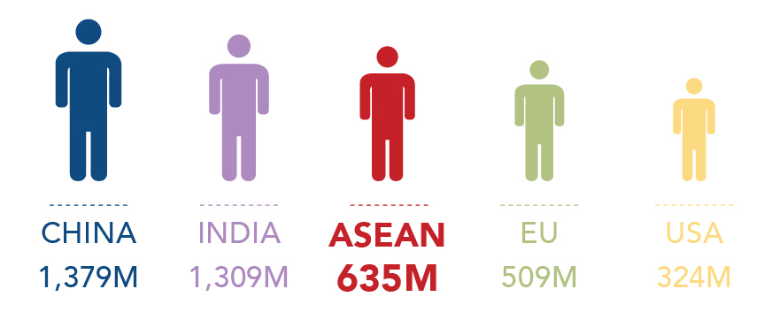
AEC at a Glance
6th
largest economy in the world, 3rd in Asia. A combined GDP of US$2.55 trillion in 2016.
3rd
largest market in the world
Total population of over 635 million.
IMF – WEO, ASEAN Secretariat, and UN World Population

Slide 6
AEC at a Glance
Total ASEAN trade stood at US$ 2.2 trillion in 2016 with intra-ASEAN trade comprising the largest share.
ASEAN was one of the largest sources of FDI flows in 2016. The region attracted US$ 98 billion in Foreign Direct Investment in 2016, 79% of which was in the services sector.
Notes:
[Technical notes on intraregional/intra-ASEAN trade: While the share of intraregional trade is often used as an indicator of integration ‘success’, it may be argued that ASEAN’s pursuit of regional integration has been placed consistently in the broader context of integration into the global economy. An increase in the share of intra-regional trade may not always be an accurate indicator of success if this takes place due to trade diversion. Intra- and extra-regional trade should be seen as complementary/mutually reinforcing, particularly in the era of global value chains (GVCs).]

Slide 7
ASEAN…
DIVERSE
Home to major religions
Rich culture
Courtesy of ASEAN National Tourism Organisations
Vast natural resources
Courtesy of ASEAN National Tourism Organisations
Courtesy of ASEAN National Tourism Organisations
Notes:
ASEAN people practice Islam, Christianity, Buddhism, Hinduism, etc
It has varied topography and vast natural resources, with rich mineral deposits, oil deposits, etc.
ASEAN people have rich cultural traditions and heritage.

Slide 8
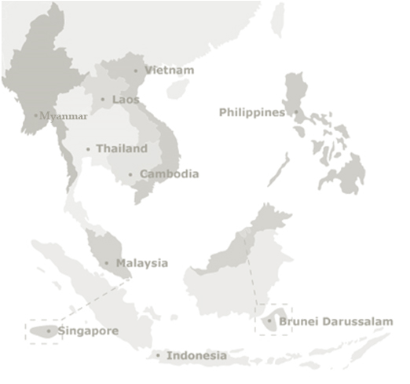
The ASEAN Journey to Community Building
2015
ASEAN Community
2007
Cebu Declaration
2003
Bali Concord II
1997
ASEAN Vision 2020
1967
Bangkok Declaration

Slide 9
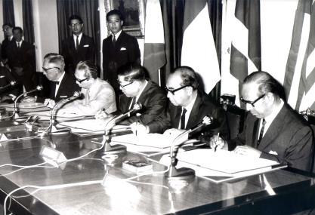
The ASEAN Journey to Community Building
Bangkok Declaration
“Accelerate the economic growth, social progress and cultural development in the region through joint endeavors.”
“Promote regional peace and stability through abiding respect for justice and the rule of law.”
1967

Slide 10
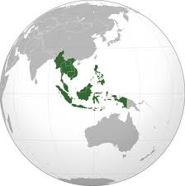
The ASEAN Journey to Community Building
ASEAN Vision 2020
“ASEAN as a concert of Southeast Asian nations, outward looking, living in peace, stability and prosperity, bonded together in partnership in dynamic development and in a community of caring societies.”
1997

Slide 11
The ASEAN Journey to Community Building
Bali Concord II
“An ASEAN Community shall be established comprising three pillars, namely political and security cooperation, economic cooperation, and socio-cultural cooperation…”
2003

Slide 12
The ASEAN Journey to Community Building
12th ASEAN Summit
Cebu, Philippines
“Accelerate the establishment of an ASEAN Community by 2015…”
2007

Slide 13
Launch of ASEAN Community – 31 Dec. 2015

Slide 14
“A politically cohesive, economically integrated, socially responsible, and truly people-oriented, people-centered and rules-based ASEAN”
ASEAN Community 2025
Consolidate the ASEAN Community through deeper and more comprehensive process of integration
Emphasis on ASEAN-centrality
Emphasis on equitable development of the ASEAN Member States
More connected ASEAN

Slide 15
ASEAN Governance
The ASEAN Charter
New political commitment at the top level
New legal framework, legal personality
New ASEAN bodies
Two new openly-recruited Deputy SecGens.
More roles for ASEAN Foreign Ministers
New and enhanced role of the Secretary-General of ASEAN

Slide 16
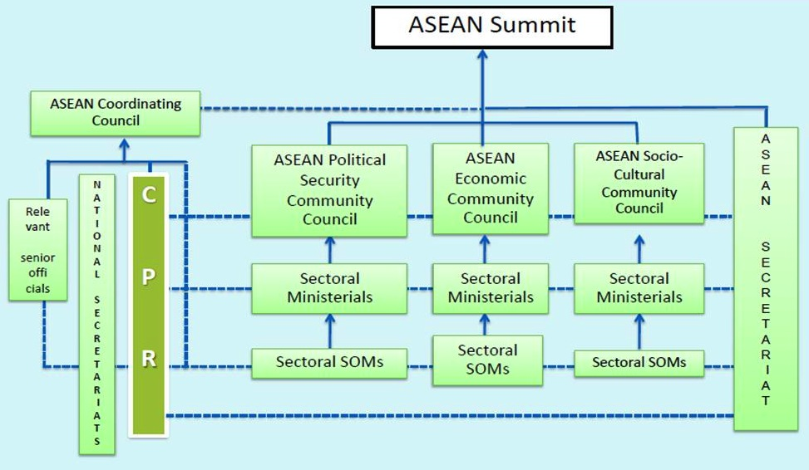
Coordination Mechanism of ASEAN

Slide 17
Overview of the ASEAN Community
ASEAN Political Security Community (APSC)
Ensures that the peoples and Member States of ASEAN live in peace with one another and with the world at large in a just, democratic and harmonious environment.
ASEAN Economic Community (AEC)
Transforms ASEAN into a stable, prosperous, and highly competitive region with equitable economic development, and reduced poverty and socio-economic disparities.
ASEAN Socio-Cultural Community (ASCC)
Contributes to realising an ASEAN Community that is people-oriented and socially responsible with a view to achieving solidarity and unity among the peoples and Member States of ASEAN.
Narrowing the Development Gap (NDG)
Progressing together through cooperation in development.
Physical, Institutional and People-to-People Connectivity

Slide 18
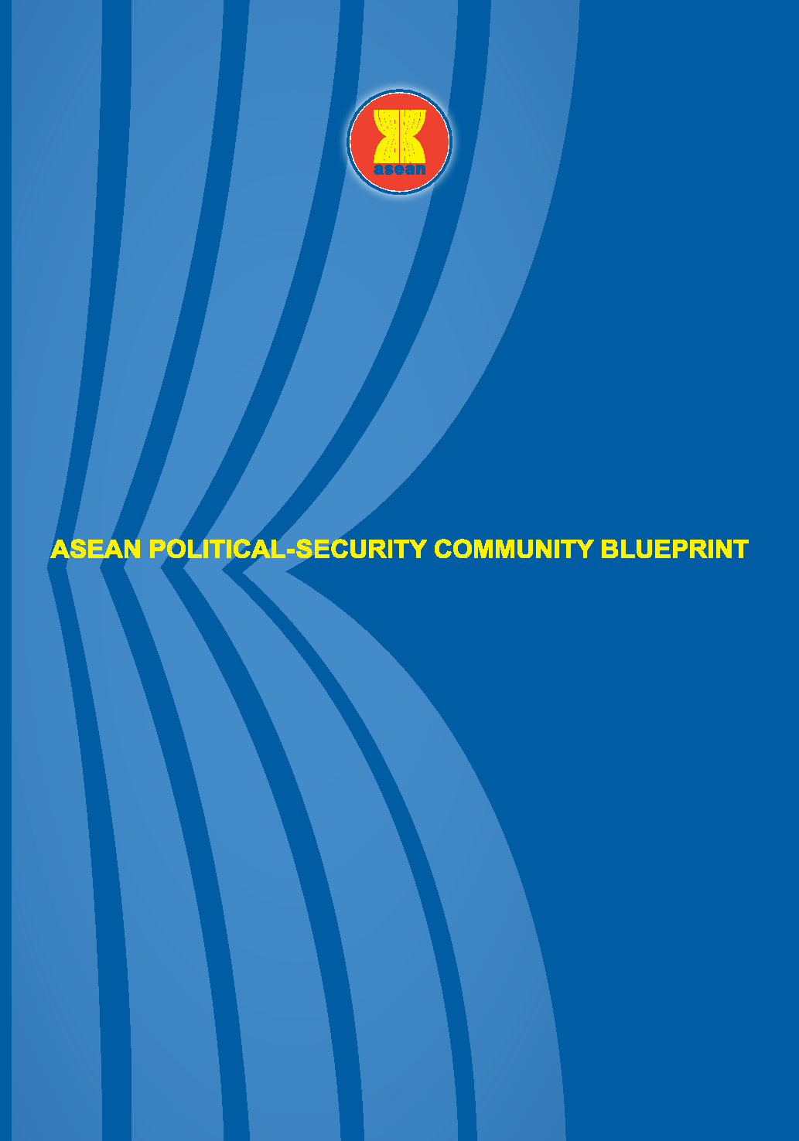
The Community Building Milestones
ASEAN Political-Security Community
Ensure that the peoples and Member States of ASEAN live in peace with one another and with the world at large
Strengthen the mutually beneficial relations between ASEAN and its Dialogue Partners and friends.
Maintains the centrality and proactive role of ASEAN in a regional architecture that is open, transparent and inclusive, while remaining actively engaged, forward-looking and non-discriminatory

Slide 19
ASEAN Dialogue Partners
ASEAN – Australia, 1974
ASEAN – Canada, 1977
ASEAN – China, 1996
ASEAN – European Union, 1977
ASEAN – India, 1995
ASEAN – Japan, 1977
ASEAN – New Zealand, 1975
ASEAN – Republic of Korea, 1991
ASEAN – Russia Federation, 1996
ASEAN – United States, 1977

Slide 20
ASEAN Sectoral Dialogue Partners
ASEAN – Pakistan, 1997
ASEAN – Norway, 2015
ASEAN – Switzerland, 2016
ASEAN – Turkey, 2017

Slide 21
ASEAN Development Partner
ASEAN – Germany, 2016

Slide 22
Developments in Political Cooperation
South China Sea- start of COC negotiations at the 23rd JWG-DOC on 1-2 March 2018 in Nha Trang, Vietnam.
Assistance to Rakhine State- The AHA Centre recently received contribution worth approximately USD 75,000 from the Government of Singapore to facilitate the provision of humanitarian assistance
TAC- growing interests of other non-ASEAN Countries to accede
APSC Blueprint 2025- 81% action lines addressed; Preliminary Review of the Implementation of the APSC Blueprint - 10th Coordinating Conference for the APSC (ASCCO)

Slide 23
Developments in the Security Cooperation: Transnational Crime
Trafficking in Persons- ASEAN Convention of Trafficking in Persons Especially Against Women and Children signed by Leaders 2015- Entered into Force
A dedicated Trust Fund to assist victims of trafficking and irregular migration have been set up in August 2017;
Guidelines on Consular Assistance by ASEAN Missions in Third Countries to Nationals of ASEAN Member States is currently in progress.
Will draft a POA on Violent Extremism in 2018

Slide 24
Developments in the Security Cooperation: Transnational Crime
Counter Terrorism and Violent Extremism
AMMTC
updated ASEAN Comprehensive Plan of Action on Counter Terrorism (ACPoA on CT) – Indonesia
Adopted - Manila Declaration to Counter the Rise of Radicalisation and Violent Extremism
Convened- 2nd Special ASEAN Ministerial Meeting on the Rise of Radicalisation and Violent Extremism
31st ASEAN Summit adopted the ASEAN Declaration on Culture of Prevention for a Peaceful, Inclusive, Resilient, Healthy and Harmonious Society.

Slide 25
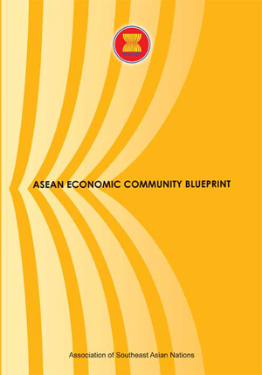
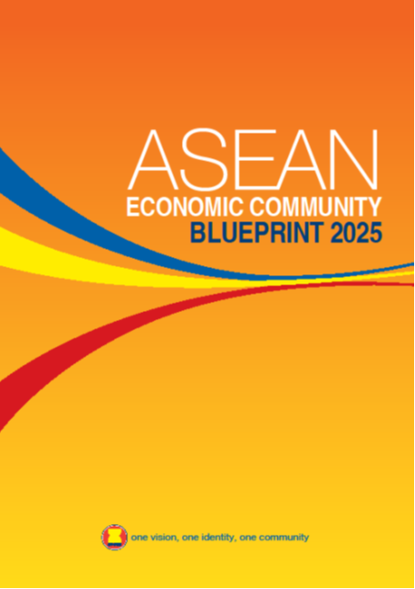
The Community Building Milestones
ASEAN Economic Community
Establish ASEAN as:
A Highly Integrated and Cohesive Economy
A Competitive, Innovative and Dynamic ASEAN
Enhanced Connectivity and Sectoral Cooperation
A Resilient, Inclusive and People-Oriented, and People-Centred ASEAN
A Global ASEAN
Notes:
The AEC Blueprint 2025 has 5 characteristics, which sets out 153 strategic measures under its elements.
There are some new elements not found in the AEC BP that were introduced to the AEC BP 2025, such as financial inclusion, global value chains, productivity growth and innovation, good governance, Effective, Efficient, Coherent and Responsive Regulations, and Good Regulatory Practice; Sustainable Economic Development; Global Megatrends and Emerging Trade-related Issues; Healthcare; Science and Technology; PPP; the role of private sector and stakeholders in regional integration efforts; and enhancing economic partnerships with non-FTA dialogue partners and engaging with other regional and global partners and institutions.

Slide 26
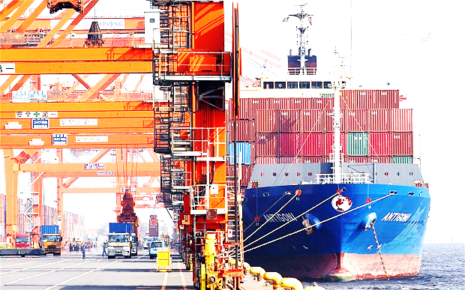
Trade in Goods
Liberalisation
ASEAN-6 → 99.2% tariff lines eliminated
CLMV → 90.9% tariff lines eliminated
Across 10 ASEAN Member States, 96.01% of all tariff lines have been eliminated
26

Slide 27
Facilitating Movement of Professionals
ASEAN Qualification Reference Framework (AQRF)
ASEAN Agreement on Movement of Natural Person (MNP)
Concluded Mutual Recognition Arrangements (MRAs) in ASEAN:
1. Engineering Services (December 2005)
2. Architectural Services (November 2007)
3. A Framework for Accounting Services (February 2009);
succeeded by MRA on Accountancy Services
(November 2014)
4. Surveying (November 2007)
5. Nursing Services (December 2006)
6. Medical practitioners (February 2009)
7. Dental practitioners (February 2009)
8. Tourism Professionals (November 2012)
Notes:
The ASEAN Qualification Reference Framework (AQRF) was endorsed in August 2014 to provide a standard for voluntary cross-referencing among the different National Qualification Frameworks of AMS.
The ASEAN Agreement on the Movement of Natural Persons, which was entered into force on June 2016, provides the legal framework to facilitate temporary cross‐border movement of people engaged in the conduct of trade in goods, services and investment.
The progress in implementing the MRAs on architectural services and engineering services are the most visible among the concluded ASEAN MRAs, partly because
of the MRA approach, which involves registration of recognised professionals at ASEAN level. Approximately, there are a total of 1,252 engineers on the ASEAN Chartered Professional Engineers Register and 284 architects on the ASEAN Architect Register.

Slide 28
A More Connected ASEAN
ASEAN Highway Network (AHN)
AHN links all ASEAN Member States by connecting 23
designated national highway routes with total length
38,400 km.
Singapore-Kunming Rail Link (SKRL)
7,000 km railway line, linking major cities in 8 countries
Framework agreements on transport facilitation
ASEAN Open Skies Policy

Slide 29
ASEAN Open Skies Policy
ASEAN Open Skies Policy allows regional air carriers to take unlimited flights to all ASEAN Member States and allows rapid expansion of air services
It leads to remarkable development of the ASEAN aviation
Capacity of ASEAN airlines increased more than tripled, from 94 million seats in 2003 to 318 million seats in 2015
Capacity to absorb international arrivals also tripled, from 33 million to 108 million in the same period

Slide 30
A Global ASEAN
ASEAN Free Trade Area
ASEAN-China FTA
ASEAN-Japan CEP
ASEAN-Korea FTA
ASEAN-India FTA
ASEAN-Australia New Zealand FTA
Ongoing negotiations: ASEAN-Hong Kong FTA and RCEP.
Notes:
ASEAN has 5 existing Free Trade Agreements (FTAs) with major trading partners, namely:
ASEAN-China FTA (ACFTA)
ASEAN-Korea FTA (AKFTA)
ASEAN-Japan Comprehensive Economic Partnership (AJCEP)
ASEAN-India FTA (AIFTA)
ASEAN-Australia New Zealand FTA (AANZFTA)
Currently, ASEAN is negotiating the ASEAN-Hong Kong FTA and Regional Comprehensive Economic Partnership (RCEP). The latter with the 5 existing FTA Partners, and is aimed at consolidating and significantly improving on the ASEAN+1 FTAs.

Slide 31
The Community Building Milestones
Enhance commitment, participation and social responsibility of ASEAN peoples through an accountable and inclusive mechanism for the benefit of all
Promote equal access and opportunity for all, as well as promote and protect human rights
Promote balanced social development and sustainable environment that meet the current and future needs of the people
Enhance capacity and capability to collectively respond and adapt to emerging trends
Strengthen ability to continuously innovate and be a proactive member of the global community
A
B
C
D
E
Notes:
In support of realising a prosperous ASEAN Community 2025, the ASEAN Socio-Cultural Community (ASCC) envisions an ASEAN Community that engages and benefits the people, and is inclusive, sustainable, resilient, and dynamic. This slide shows the five main ASCC characteristics, which will be explained in detail in the succeeding sections.

Slide 32
Key Result Areas
A
Engages and benefits people
Engaged Stakeholders in ASEAN processes
Empowered People and Strengthened Institutions
B
Reducing Barriers
Equitable Access for All
Promotion and Protection of Human Rights
Inclusive
Conservation and Sustainable Management of Biodiversity and Natural Resources
Environmentally Sustainable Cities
Sustainable Climate
Sustainable Consumption and Production
C
Sustainable
Notes:
The first characteristic is: Enhance commitment, participation and social responsibility of ASEAN peoples through an accountable and inclusive mechanism for the benefit of all. The Key Result Areas for this are: 1) engaged stakeholders in ASEAN processes; and 2) empowered people and strengthened institutions.
The second characteristic is: Promote equal access and opportunity for all, as well as promote and protect human rights. The Key Result Areas for this are: 1) reducing barriers; 2) equitable access for all; and 3) promotion and protection of human rights.
The third characteristic is: Promote balanced social development and sustainable environment that meet the current and future needs of the people. The Key Result Areas for this are: 1) conservation and sustainable management of biodiversity and natural resources; 2) environmentally sustainable cities; 3) sustainable climate; and 4) sustainable consumption and production.

Slide 33
Key Result Areas
A disaster resilient ASEAN that is able to anticipate, respond, cope, adapt, and build back better, faster and smarter
A safer ASEAN that is able to respond to all health-related hazards including biological, chemical, and radio-nuclear, and emerging threats
A climate adaptive ASEAN with enhanced institutional and human capacities to adapt to the impacts of climate change
Strengthened social protection to reduce vulnerabilities in times of climate change-related crises, disasters and other environmental changes
Enhanced and optimised financing systems, food, water, energy availability, and other social safety nets in times of crises by making resources more available, accessible, affordable and sustainable
Endeavour towards a “Drug-Free” ASEAN
D
Resilient
E
Dynamic
Towards an open and adaptive ASEAN
Towards a creative, innovative and responsive ASEAN
Engender a culture of entrepreneurship in ASEAN
Notes:
The fourth characteristic is: Enhance capacity and capability to collectively respond and adapt to emerging trends. The Key Result Areas for this are: 1) a disaster resilient ASEAN ; 2) a safer ASEAN that is able to respond to all health-related hazards; 3) a climate adaptive ASEAN; 4) strengthened social protection to reduce vulnerabilities; 5) enhanced and optimised financing systems, food, water, energy availability, and other social safety nets; and 6) a “Drug-Free” ASEAN.
The fifth characteristic is: Strengthen ability to continuously innovate and be a proactive member of the global community. The Key Result Areas for this are: 1) towards an open and adaptive ASEAN; 2) a creative, innovative and responsive ASEAN; and 3) Engender a culture of entrepreneurship in ASEAN.

Slide 34
ASCC Visions, Objectives and Strategic Measures will be addressed by 15 ASEAN Sectoral Bodies/Organ
1. Health
2. Education
3. Youth
4. Sports
5. Culture and Arts
6. Social Welfare
7. Gender and women empowerment
8. Poverty eradication and rural development
9. Rights of women and children
10. Environment
11. Haze
12. Disaster Management
13. Labour
14. Civil Service
15. Information
16. Others (AHA, AUN, etc.)
ASCC Sectoral Bodies/Organ also contribute to the APSC and AEC.
Notes:
As the “people pillar”, the ASCC, devotes time and attention to 15 sectors including education, culture, information, environment, health, labour, civil service, disaster management, poverty eradication, gender, youth, sports, social welfare and others.
Indeed, ASCC is an important pillar that serves as a converging platform for ASEAN integration. Since it focuses on the development of the peoples of ASEAN and the desire to develop a stronger regional identity, the ASCC puts a human face to the ASEAN integration efforts.

Slide 35
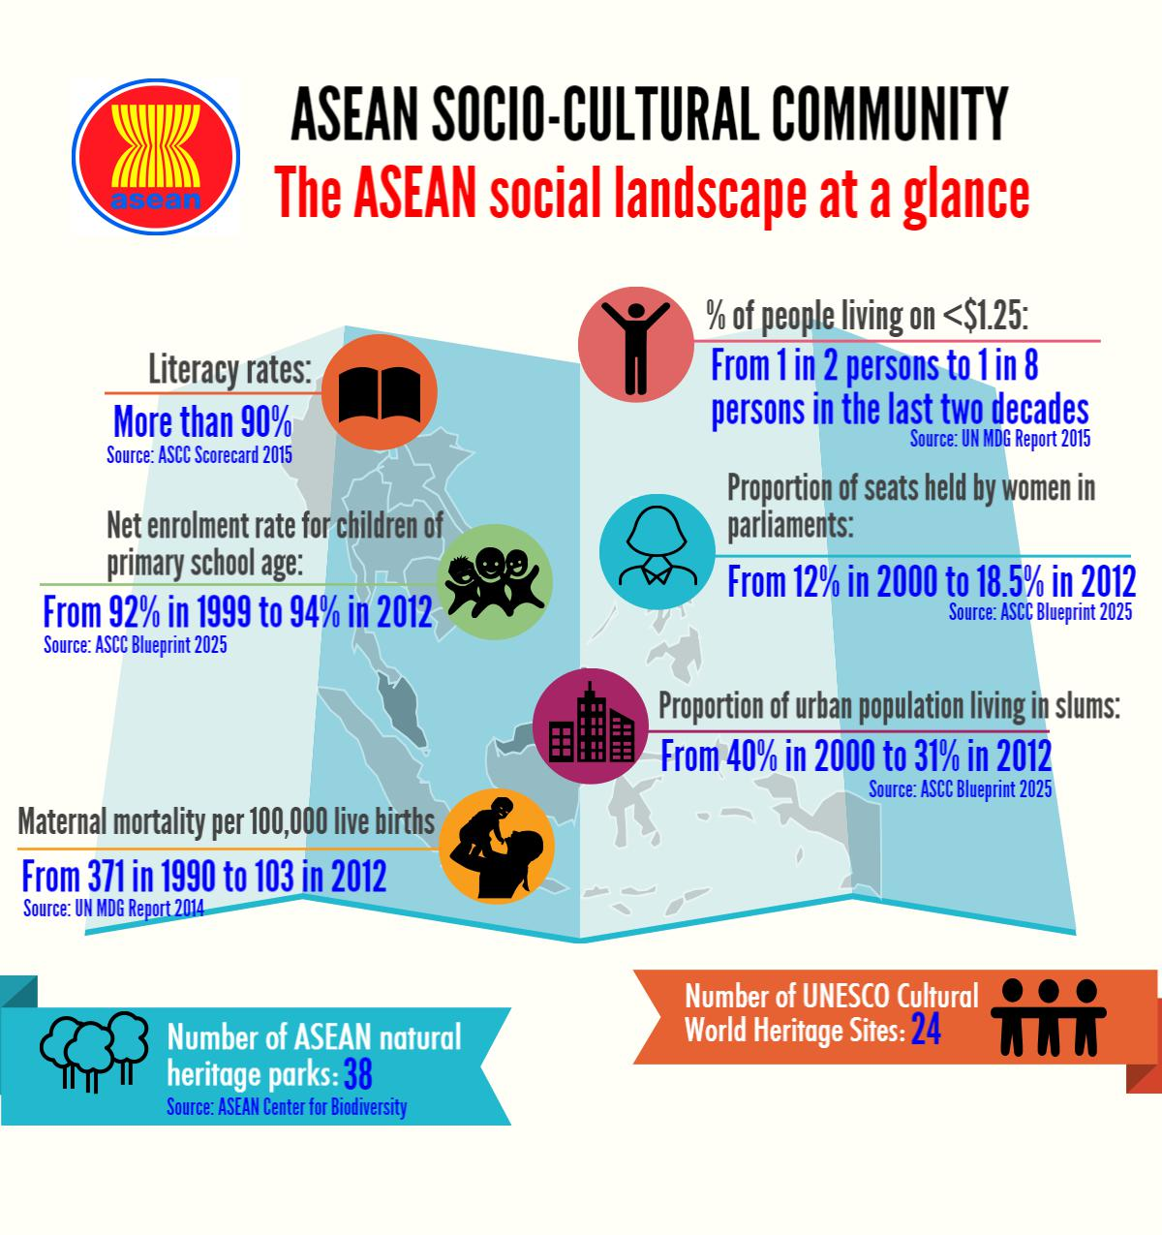
Notes:
In term of socio-cultural landscape:
ASEAN has impressive progress on poverty reduction. The Percentage of people living on < US$ 1.25: decreased from 1 in 2 persons in 1990s to now 1 in 8 persons.
ASEAN also achieved close to universal access to primary education with Net enrolment Rate for Children at primary school age improved from 92% in 1996 to 94% in 2012. By 2014, some AMS have 100% of net enrollment. In many ASEAN Member States, almost all children do not only enter primary education but also complete it.
Over 50% of ASEAN population are in active employment age. The labour participation rate across AMS where data is available (8) is between 67% (PH) to 83% (Cambodia) in 2014.

Slide 36
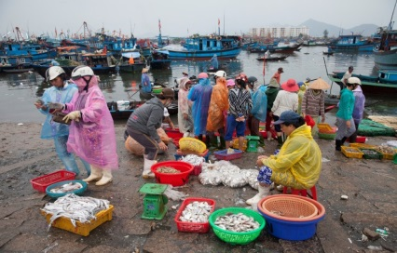
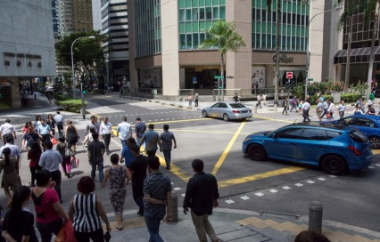
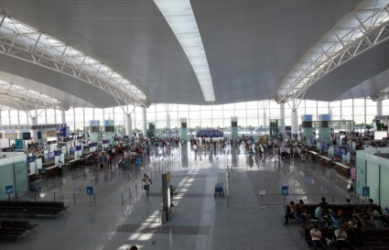
Benefits of ASEAN Cooperation
Peaceful life for the citizens
Lower Cost of Living; more choices
Better Jobs and Quality of Life
Working and Studying Abroad
Easier Travel

Slide 37
Gap between rich and poor AMSs remains very large and AMSs have a mixed record on income inequality.
Many regional initiatives were not able to be incorporated into national plans, as the less developed countries faced resource constraints to implement the regional commitments.

Slide 38
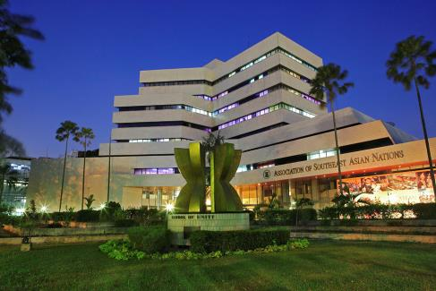
The ASEAN Secretariat
Jalan Sisingamangaraja 70 A
Jakarta 12110 Indonesia

Slide 39
ASEAN Secretariat
Established on 24 February 1976 by the Foreign Ministers of ASEAN
Existing ASEAN Secretariat premises in Jakarta officiated in 1981
Staff recruited locally and from the ASEAN Member States
ASEC Mission: To initiate, facilitate and coordinate ASEAN stakeholder collaboration in realising the purposes and principles of ASEAN as reflected in the ASEAN Charter.

Slide 40
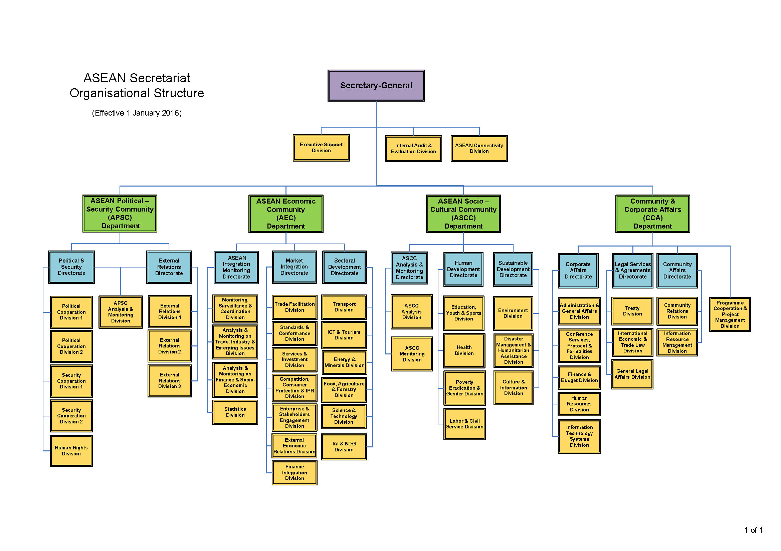
Effective from 1 Jan 2016

Slide 41
Current Staff Composition
Secretary-General
Deputy Secretary-General (APSC & ASCC)
Appointed on rotation basis
Appointed on rotation basis
Deputy Secretary-General (AEC & CCA)
Director
Assistant Director
Senior Officer
Openly Recruited Staff
Openly Recruited Staff
Technical Officer
Technical Assistant
Specialized Staff
General Services
Locally Recruited Staff

Slide 42
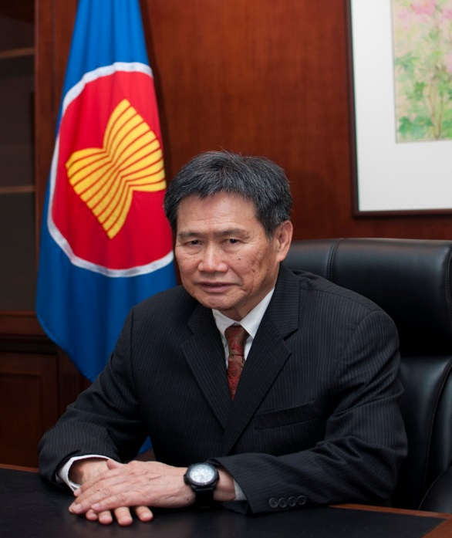
Secretary-General of ASEAN (2018-2022)
H.E. Dato Lim Jock Hoi
from Brunei Darussalam
Carry out duties and responsibilities in accordance with the provisions of the Charter and relevant ASEAN instruments, protocols and established practices
Facilitate and monitor progress in the implementation of ASEAN agreements and decisions
Participate in meetings of the ASEAN Summit, ASEAN Community Council, ASEAN Coordinating Council, and sectoral Ministerial bodies

Slide 43
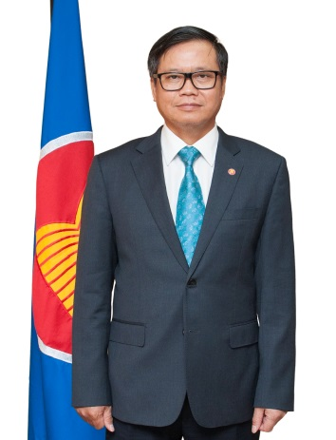
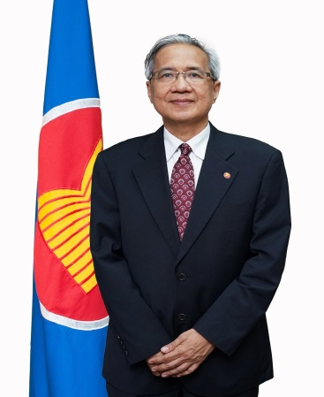
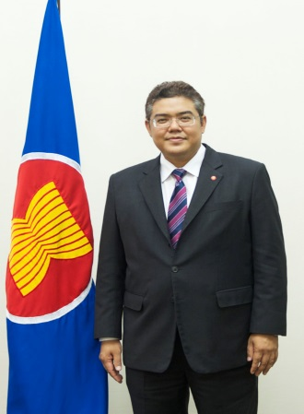
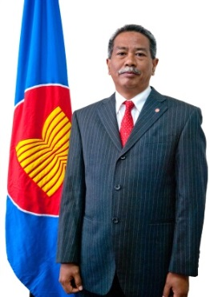
Deputy Secretaries-General
The ASEAN SG is assisted by four Deputy Secretaries-General from different nationalities and from four different ASEAN Member States.
Hoang Anh Dr Aladdin Vongthep Dr AKP Tuan D. Rillo Arthakaivalvatee Mochtan
(Vietnam) (Philippines) (Thailand) (Indonesia)
APSC AEC ASCC Community and
Corporate Affairs (CCA)

Slide 45
Thank you
chei-zu tin-bar-te
GrKuN
Terima kasih
ขอบคุณ
ຂໍຂອບໃຈ
Salamat Po
cảm ơn

