Slide 1
PREPARATION OF GMP REPORT
Malaysia & Indonesia

Slide 2
OBJECTIVE
To review the activities after GMP inspection.
Notes:
2
The objectives of this module are to review the activities that need to be carried out when you are preparing for an inspection. We will look at the key issues relating to the preparation for an inspection and review the particular issues that relate to inspections in your country.

Slide 3
POST-INSPECTION
Definition of deficiencies
Inspection report format
Inspection report details
Inspection report distribution
Follow–up action

Slide 4
DEFICIENCIES
All deficiencies found should be listed, even if corrective action has taken place straight away.
If the deficiencies are related to the assessment of the marketing application, this should be clearly stated.
Notes:
4

Slide 5
DEFICIENCIES
Deficiencies classification:
Critical
Major
Minor
Notes:
5

Slide 6
EXAMPLES
CLASSIFICATION | EXAMPLE OF DEFICIENCIES:
Critical | The design of the manufacturing premises did not meet the basic GMP requirement. Examples: No changing room and buffer room for raw material and packaging material provided. Storage of raw material was inside the production area.
Major | There were a number of important documents which have yet to be established by the company. Example; Procedures for handling the receipt of raw materials. Maintenance procedures for water systems dehydrated ion (DI Water) Records of cleaning activities in the area of production. Stocks cards for raw materials and packaging materials stored in the storage area.
Minor | Procedures for handling medical examinations were provided. However, no information on the frequency of health checks specified in the mention procedures .
FOR FORTHER INFORMATION: REFER TO CLASSIFICATION OF GMP NON-CONFORMANCE TRAINING MODULE
Notes:
6

Slide 7
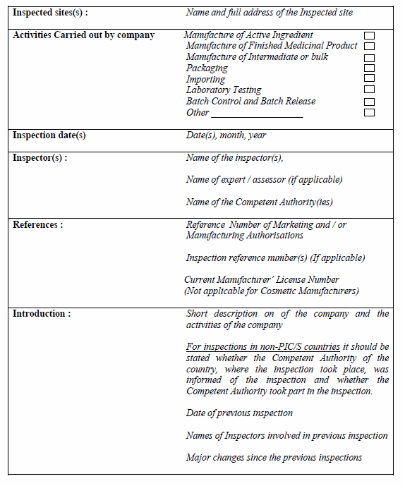
INSPECTION REPORT FORMAT
Inspection Report content:
General information on company.
Notes:
First part, General information about the company can be taken directly from the information provided by the company itself, provided it is annotated as such and verified during the inspection.
The second part should describe the progress of the inspection, listing all the parts of the factory, warehouse, laboratory etc that have been inspected.
The third part is devoted to observations, either negative or positive, including any major changes (improvements and deterioration) that have taken place since the previous visit. Negative observations should differentiate between poor systems and failure to comply with the system. An example is lack of cleaning in a particular area. Is it due to an inadequate SOP, or lack of compliance with an SOP that covers all aspects of cleaning.
Positive observations should be recorded A description of the process that is carried out particularly well and would be considered as examples of good manufacturing practice.
The final part consists of the inspectors’ summary and conclusion, including corrective actions and recommendations. You could also add any supplementary documentation as annexes to the report.

Slide 8
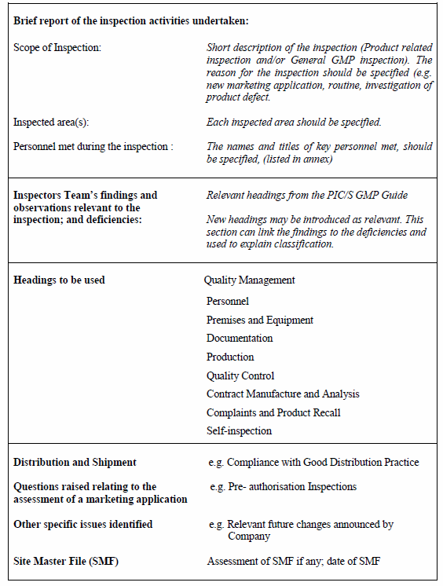
INSPECTION REPORT FORMAT
Inspection Report content:
Description of the inspection.
Observations.

Slide 9
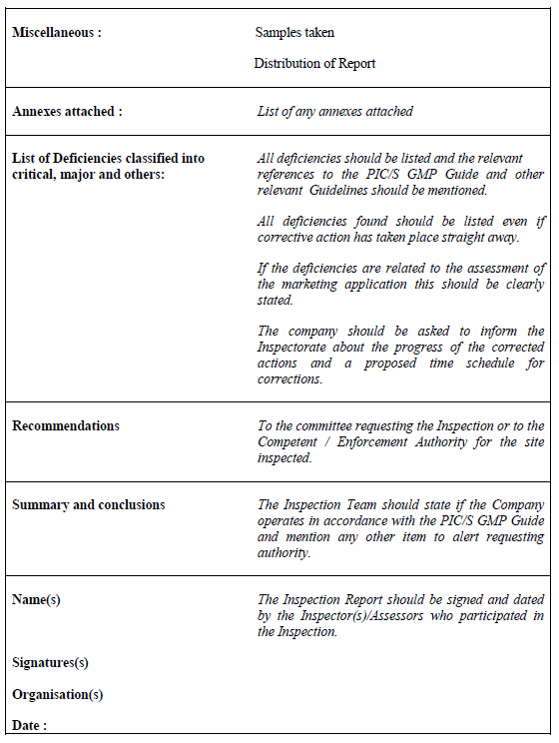
INSPECTION REPORT FORMAT
Inspection Report content:
Conclusion and recommendation.
Annexes-Attendance List.
Inspector(s) signature.

Slide 10
REPORT WRITING
All inspections conducted should be reported using a standard format.
Report should be written by inspector(s) involved. Compiled by the Lead Inspector.
Keep it simple and based on fact.
The conclusion of the GMP Inspection should be stated at the end of the report followed by a disclaimer and signed by the inspector(s).
Notes:
The whole inspectorate should have a consistent style for inspection reports that is used by everyone (using a standard format). Here are a few suggestions on making the report readable and effective:
Use the past tense: “It was observed...” or “It was noted that...”
Keep it simple and based on fact - it is not necessary to complicate the report. There is no room for opinion or ambiguities - remember the specifics that we discussed earlier when referring to documents, products or equipment.
There are some aspects that should not be included in the report, although they may be discussed at the exit meeting if appropriate:
Your subjective opinions as opposed to fact.
Information that is not relevant to the inspection.
Ambiguous statements that cannot be supported.
Antagonistic statements that do not contribute to the inspection.

Slide 11
REPORT WRITING
Do not include:
Subjective opinions
Irrelevant information
Ambiguous statements
Antagonist statements
Notes:
The whole inspectorate should have a consistent style for inspection reports that is used by everyone (using a standard format). Here are a few suggestions on making the report readable and effective:
Use the past tense: “It was observed...” or “It was noted that...”
Keep it simple and based on fact - it is not necessary to complicate the report. There is no room for opinion or ambiguities - remember the specifics that we discussed earlier when referring to documents, products or equipment.
There are some aspects that should not be included in the report, although they may be discussed at the exit meeting if appropriate:
Your subjective opinions as opposed to fact.
Information that is not relevant to the inspection.
Ambiguous statements that cannot be supported.
Antagonistic statements that do not contribute to the inspection.

Slide 12
REPORT WRITING
When reporting non-compliances the following aspect should be considered:
It must be possible to identify exactly where the non-compliance was and, therefore, the location, piece of equipment, document or job title of individual referred to must be identified.
The non-compliance should be described according to the relevant PIC/S chapters or any GMP guideline that was made for reference at the time of inspection.

Slide 13
GMP INSPECTION REPORT
REPORT WRITING
REMEMBER!!!
Inspection reports are treated as
confidential documents.
Notes:
Inspection reports are normally treated as confidential documents, depending on national legislation. However, under certain international agreements, reports are exchanged between regulatory authorities (e.g. mutual recognition agreements, memoranda of understanding or signatories to co-operation schemes).

Slide 14
REPORT DISTRIBUTION
The inspection report: Sent out to the company.
Company must reply to the inspection report within 30 days unless there is acceptable reason.
Notes:
14
After the report has obtained supervisory approval, it should be sent with a covering letter to the company management.

Slide 15
FOLLOW UP
The Head of GMP Compliance will received the company’s response letter and forward it to the inspector for review.

Slide 16
FOLLOW UP
Deficiencies may be considered as resolved if the response letter:
States that corrective and preventative measures have been implemented, and includes supporting documentation, if necessary.
Provides a written commitment, providing a clear and reasonable schedule for implementation of corrective and preventative measures.

Slide 17
FOLLOW UP
If the corrective and preventative measures taken by the company are not considered to be acceptable, further correspondence may be necessary.

Slide 18
PUNITIVE ACTION
Unacceptable GMP Compliance
Compliance related communications which alert the manufacturer to the regulatory authority’s concern, and possibility for future regulatory action if remedial action is not effective
Regulatory action against the site authorisation or GMP approval (refusal, suspension or amendment of an establishment licence)
Market action such as recall (voluntary or mandated by regulatory authority)
Prohibition of supply/ importation
Prosecution
Communications to the public using public warning/ public advisory or information updates;
Suspension or cancellation of Marketing Authorisation/Product Licence
Health product label or changes
Notes:
The inspectorate of a regulatory authority normally has certain powers to allow for regulatory actions. The regulatory actions are based on and controlled by national legislation
The purpose of the regulatory action is to ensure that unsatisfactory situations in manufacturing sites are corrected in the interest of the public by ensuring that safe, effective, quality pharmaceutical products are manufactured.
These powers or regulatory actions often include:
- Closure of a facility (only used in an extreme case where a health hazard is perceived)
- Suspension or revoking of the marketing authorisation.
- Delay in approval of licenses or marketing authorisations.
- Delay in issue of a GMP certificate.
- Initiation of a product recall.

Slide 19
REFERENCES
PIC/S INSPECTION REPORT FORMAT; PI013-3; 2007
NPRA PROCEDURE FOR PREPARING A GMP INSPECTION REPORT : PKP/200/309

